Slide 1
Reinventing myself
Making the Change, Humans of IT
Tech Community APAC Online 07 Mar 2020
Notes:
Thank you for being here and for staying through. Diane and I are excited to share our stories and we hope that from this, you take away some ideas and encouragement to Making the Change that yourself

Slide 2
You are here for a reason

Slide 3
To figure out if a change is due

Slide 4
Careers are not always ladders and straight paths
Notes:
Today, technology is advancing so quickly and changing the way we work dramatically. With so much access to information, alternative education, opportunities - career paths are becoming less predictable.
The one thing - is that careers do not always have to be ladders and straight paths

Slide 5
49%
Source: http://blog.indeed.com/2019/10/30/career-change/
Notes:
a survey conducted in 2019 by the job search site Indeed found that 49% - nearly half! of workers have made a dramatic career shift - for example, from marketing to engineering or from teaching to finance.
And among those who haven’t, 65% say they’re either thinking about, or have previously considered, switching

Slide 6
53%
Source: https://sg.yougov.com/en-sg/news/2019/10/03/half-singaporeans-work-jobs-unrelated-their-degree/
Notes:
Closer to home in Singapore, research showed that 53% of Singapore graduates are currently working in jobs unrelated their degrees.
Today I want to share my own non-linear journey with you.

Slide 7
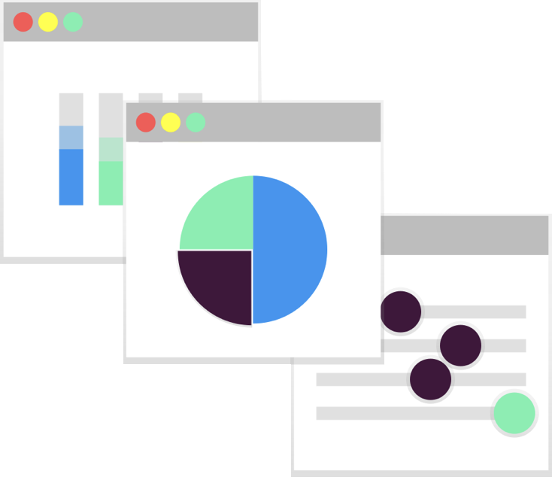


First transition
2014
2017
2013
2016
First job
Discovered Techladies
Attended Bootcamp #2 graduation party
Notes:
To do that, I have to rewind back to college days
Prior to college, I had little to no exposure in programming and computer science. In fact, the only time I remember typing into a terminal was to enter cheat codes for my computer games, like getting more money for my Sims :’)

Slide 8
Notes:
That’s right

Slide 9
First transition
2014
2017
2013
2016
First job
Discovered Techladies
Attended Bootcamp #2 graduation party
Notes:
Now, my first experience with coding came in the form of C++, when I took an Introductory programming course in my final semester in college. Although I don’t remember what exactly I built, I distinctly remembered feeling empowered to have been able to build something from typing some lines into the editor.
That was enough to keep me intrigued. But because it was final semester and it was too late to do anything about it, I graduated with a very unrelated degree in Economics and Philosophy. I came back to SG and started my first job as a broker.
About 18 months in, sometime in 2016, I saw an opportunity and did an internal transfer to become a business analyst. That was my first transition. In that role I started to do some minor VBA coding. As I got myself back into coding, that sense of enjoyment came back. I signed up for some online courses and checked out community groups, so of course FB advertising algorithm figured that I ‘might be interested’ in this group called TechLadies.
I saw that they had this upcoming bootcamp graduation party, and something in me decided to go and check it out.

Slide 10
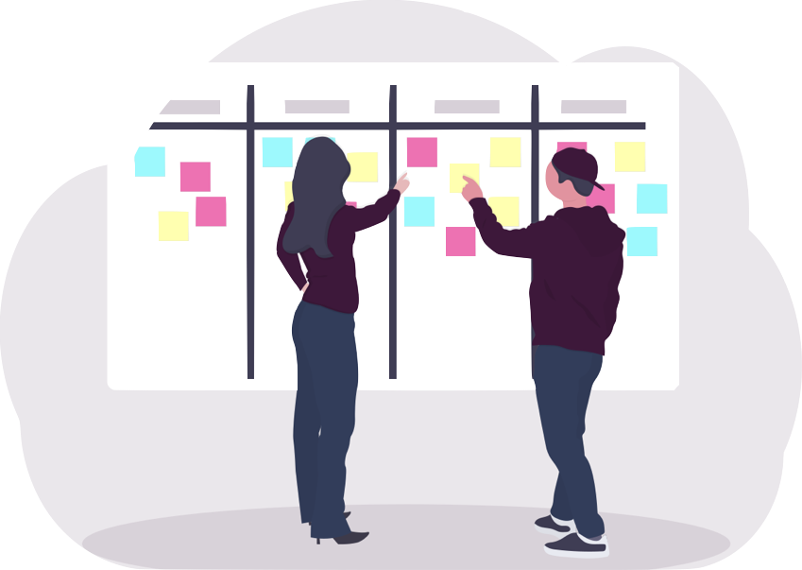

Left job
2018
Applied for Bootcamp #3
Built our first project on RoR!
Applied for Jumpstart! Programme
3-month full time bootcamp
Notes:
After hearing encouraging stories from the bootcamp graduates, I went home and did more research on ways to become more involved. Having done some tutorials here and there, I knew I wanted to apply for a bootcamp/course in order to work with an actual team with industry people to build an end-to-end product.
And so, That same year, I decided to apply for the TL bootcamp. I thought this to be a good testing ground as I committed ~1 day a week for 3 months to pursuing this without compromising my income nor my full-time job.
After the bootcamp I took some time to consider if this was what I wanted to do. During this period I found ways to become more involved - talking to people, going for conferences, volunteering for TechLadies etc. I wanted to ‘live it’ just to get a taste and see if this was what I really wanted to do.
Sometime in mid-2018 I decided to take the plunge. I left my job and committed myself to a 3 month full-time bootcamp with Thoughtworks - where I wrote code from 9 - 5

Slide 11

Started work as a Frontend Developer
2019
Notes:
After the bootcamp ended, I thought about the types of roles that would allow me to work on the things I am interested in and apply the skills that I have picked up so far, not just the tech stuff but the skills I have picked up from my previous role as well. I saw this next role as a re-invention; almost like a new season of my career journey.
I know I wanted to spend my day building things that are functional and beautiful, while still be able to work with people. In the end, I thought front-end development would allow me to be critical, logical and creative at the same time.
In hindsight, before I had even known it - I realised that I had loosely followed ‘Design thinking’ methodology.

Slide 12
Test
Empathise
Design Thinking
Prototype
Define
Ideate
Notes:
Design thinking is a process for problem solving. It is an iterative approach that involves breaking down a problem > generating ideas and exploring options >
testing these solutions. It has a bias towards action, and it works because ultimately, the solutions are crafted around what is desirable and viable for you.

Slide 13
Empathise
Design Thinking
Notes:
The first step towards this process is Empathy. In our context, Empathy involves understanding your own needs and motivations, as well as finding out who will be impacted by your decisions. Articulate your work view and life view in order to gain clarity about what you find meaningful. Understanding your influences can also help build a solid foundation for the next steps.
Once you have your notes, organise them to find themes - passions/interests, skills/strengths etc.

Slide 14
Empathise
Design Thinking
Define
Notes:
Next, we define the problem. What is the problem you are trying to solve? Are you looking for more flexibility in working hours, more meaning, pick up a new skill?
Our challenge to you is therefore:
To think about what you like/ dislike about your work now? It’s not enough to say, “I want to change jobs”, you really need to dig deep and find out the underlying reasons.
What parts of your past and current jobs, hobbies and activities do you enjoy the most?

Slide 15
Empathise
Design Thinking
Define
Ideate
Notes:
The next step is to ideate. This is a values alignment exercise where you take your values and skills sets and think about how to apply them. Put aside your limitations for the moment and write down as many ideas as you can. No idea is too small nor too big. Think far, think wide.

Slide 16
Empathise
Design Thinking
Prototype
Define
Ideate
Notes:
Then, you converge to focus on 1 path and prototype to get clarity around the work you are interested in.
Reach out to your network, grab coffee with people who have careers that match those on your list. You can start by taking up a course, attend a conference, or volunteer. That way, you can learn quickly whether it’s for you. Doing research is easy but you will never know until you try. The idea is not just to read an article but the gain some real world insight.

Slide 17
Test
Empathise
Design Thinking
Prototype
Define
Ideate
Notes:
Finally, take what you learned and use that feedback to refine your plan. You can start slow upskilling in your current role to take up projects that align with your career direction. I went a bit drastic - that came in the form of applying for the full-time programme with Thoughtworks and eventually, landing myself a role as a front-end developer.
I’ll now hand over to Diane, who will be diving a little deeper and sharing her take on this. We’ll start with this word - composing.

Slide 18
Composing
Notes:
Thanks, Min, so much for sharing your story, and how you have crafted your Career.
I’m Diane Boettcher, and have made many changes over the years. I first graduated from college back in the late eighties, served in the US Navy as a flight officer, worked in healthcare IT, lived in Spain, Germany, Hawaii, Guam, several different places across the United States, and now Singapore. Some might say that I’m further along in my career journey, or career path. The challenge with that though is that when we think of our careers, our lives as journeys, we often struggle to enjoy the journey. So much so, that we have to remind ourselves to enjoy the journey. You see, journeys necessarily have destinations. And we end up focusing on the destination, where we’re headed. Our eyes are on the prize, on the next level, on the next job. When we think of our career as a path that framework shapes our thinking about the jobs we take as steps on that path. I’d like to offer you another framework.

Slide 19

Notes:
Life is music, and your career is a symphony. And, as a symphony, you’ll have different movements. Some movements will be fast, with the strings setting the pace. Other movements will have more bass and drums. Movements may slow down, as you start your family or take care of an aging parent. You don’t rush to the finale. Because a symphony isn’t the finale. And you get to play music.
And you get to enjoy each movement, you get to enjoy each part, you get to play!

Slide 20
Evaluating the need to change
Notes:
How do you know that it is time to wrap up the movement that you’re in? In the design thinking framework, this evaluation can be a continual process.

Slide 21
Defining your Avocation
Enjoyment
At a simple level, your avocation will be fun. You will find moments, hours and even days enjoying yourself in simple pleasure
Enjoyment
Ikigai
Reward
Being paid, allows for independence, as well as being tangible evidence that we are providing value.
Skilled
Reward
Skilled
Being good at what we do provides a sense of excellence and accomplishment.
Purpose
Purpose
When our daily labors align with our purpose in life, we can endure difficulties with cheer.
Notes:
Ikigai is a concept that might also be called avocation. Our avocation is what we are called to do. If what you’re doing, what you’re playing, is your avocation, it will have the following components.
Enjoyment might be more simply be described work that you enjoy doing. It’s the work that you would do even if you weren’t being paid. It’s the thing that gets you out of bed to say, “Yippee, skippy, I get to do *this* today!”
Reward might be simply work that you will be paid for. Most of us need to make our way in the world, to pay for food, rent, clothing. Our salary, our pay, can also be an external validation, a statement that what we’re doing is valued by others. And for some of us, our pay is a way of keeping score. There’s nothing wrong with that. That’s fine. Just know that you’re keeping score that way.
Skilled can also just be work that you’re good at. Doing things that we can do makes the work easy, it gives us a sense of accomplishment.
Finally, we have fulfill our purpose when we believe the work we do needs to be done in the world. Our experiences, our lives, have shown us different things so we each have a unique sense of purpose.
When the work we do is work we enjoy, work we can be paid to do, work that we’re good at and work that we believe needs to be done in the world, that – well, that, my friends, is joy.
And realistically, we may not be able to hit all four circles at the same time with the same work. We may find that our job, our career, hits three of the four notes. That may be enough. That may be what we need at that time. And then we find the fourth note in another part of our lives.
I mean, first we must discern some of these things – what do I enjoy? What am I good at? What will people pay me to do? And what needs to be done?
And again, as you play your symphony, you may find that you enjoy different things, or that you are able to be paid less, or need to be paid more. The discernment is an exercise that we must revisit from time to time. Perhaps not every day – that would be exhausting! Perhaps annually though, we can take some time to think about the music that we’re playing and whether we’re still in that state of joy, that state of ikigai.

Slide 22
What is missing?
Enjoyment
Skilled
Reward
Purpose
Notes:
So, let’s take a minute and talk about what it feels like, what it looks like, when something is missing.

Slide 23
Misery
Skilled
Reward
Purpose
Notes:
When we don’t enjoy the work, misery follows. We’re working for the weekend, planning each vacation and only laughing, smiling, when we’re on break or when we’re goofing off from the paid work.
Work is miserable. We dread Mondays and say, “Thank goodness it’s Friday!” every week. We might also say things like, “that’s why it’s called work,” or “it’s a good thing that they pay us!”

Slide 24
Enjoyment
Skilled
Reward
Discontent
Notes:
If you’re missing purpose, you will likely be discontented. You may not notice for a while. After all, you enjoy the work, you are being paid and you’re good at it. That’s pretty solid, isn’t it?
The discontent might be a small nagging feeling of, “Is this all there is?” or “What’s the point?”

Slide 25
Enjoyment
Skilled
Stress
Purpose
Notes:
If you are missing pay, or reward, you will be stressed. Unless you have another way to pay the bills, you will be spending much of your time worrying about how to cover an emergency expense, or even just your monthly needs.

Slide 26
Enjoyment
Frustration
Reward
Purpose
Notes:
And finally, if you lack skill at your job, you will be frustrated. It’s often tempting to think boldly, “well, I can do anything if I put my mind to it,” and that’s true – to an extent. If you lack the training or the education to do a job well, you will be spending much of your time, much of your day, working longer and harder than others. And that’s incredibly frustrating.
In these cases, you can invest time and energy to learn a new instrument. Or you can find an instrument that is better suited to your current skills.

Slide 27
Ideating through what should change
Side-Hustle
Geography
Role
Industry
Employer
Notes:
So, again, if your job lacks more than one of the elements, more than one of the notes to your music, then you should ideate through what to change.
You can always pick up a side-hustle, or a side-helping. Volunteering in your community, with the elderly or with children, in your place of worship, can give you purpose, or joy at using your skills. A second job, perhaps online, can provide additional pay or a use of your talents. A hobby may give you the tune that allows you to do work that you enjoy.
If your current situation is only missing one note, one element, then a side-hustle, volunteering or hobbies may be the right tune to play.
Of course, many of us when thinking of changes, think of changing something with your paying job.
You can stay in the same industry, perhaps even the same company and simply change roles. For example, I’ve been at Microsoft for 5 years, and – although I’ve held the same title throughout that time – my actual role has changed twice.
You can change companies. In 2020, we’re finding more and more companies are baking purpose into what they are doing. That may be the right tune. You stay in the same industry and join a company whose mission speaks to you.
Changing industries, as Min has, is another way to modulate the key of your symphony. You pick up a new instrument, a new skill, a new tune.
Also, changing geographies, moving to a new country or a new city can be the change that you need.
None of these things are mutually exclusive. You can change all of these at once, although that might be the toughest way to transition. So, let’s talk about some options.

Slide 28
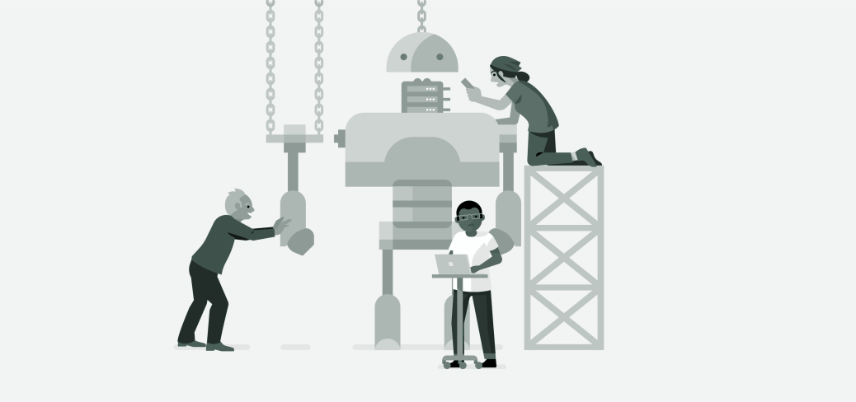
Prototyping for capability network reputation
Professional Organizations
Education
Practice, practice, practice
Notes:
As you work to create joy, you can prototype to expand the universe of things that you are good at. Education and training will expand your capability, as well as helping you discern what you enjoy doing.
Another consideration is that if you’re looking to do a new role – shifting into code development, for example – you will need to expand your network. After all, to get paid for the new skill, you will need to be able to convince someone to that you have this new skill. Professional organizations are an amazing place to do this. Every profession, every industry has a professional organization, or even several. Certainly you’ll want to attend the monthly meetings. To really elevate your profile, go a step further and volunteer with the organization. By volunteering with others in your industry, you will build your network and your reputation.
A woman I know volunteered at an professional organization’s monthly luncheon. She worked the registration desk, and when someone from her targeted company checked in, she asked if they could sit together and if she could learn about the company.
Also, getting references from people with whom you’ve worked is exponentially more powerful than references from those with whom you’ve merely networked.

Slide 29

Testing for fit
What must be true
What can’t be true
What would be nice
Notes:
Following your prototyping, you need to test. And to test, you will need criteria. You should develop criteria in three categories.
First, what must be true? Is it location? Pay? Company size or mission? What things are absolute must haves?
Second, what can’t be true? Perhaps – like me – you don’t want to be in sales. I’ve carried a sales quota in the past and don’t care for it. It’s simply not who I am. I know this and therefore will not take a new opportunity if it requires me to carry an individual sales quota. What things are absolute must nots?
Finally, what things are negotiable? Perhaps you prefer to work from home, and yet could go into an office two-three days a week. Perhaps you enjoy traveling for work, although can do without it if other things are true. Know which of your criteria are flexible.
As opportunities emerge, you can test if the change is the right tune for you with these criteria.

Slide 30
Stepping into Learning
Danger Zone
Learning Zone
Comfort Zone
Notes:
One last framework for thinking about making the change is that you will need to step into learning. And learning is inherently uncomfortable.
Obviously, staying in our comfort zone is, well, comfortable. Stepping into learning means that you need to get comfortable being uncomfortable. Being self-aware of your current capabilities and your current gaps will help you discern how far you can step out without crossing into the Danger Zone. The Danger Zone is that place where too much has changed too quickly. You put you and your team at risk.
For example, as cool as I think it would be to run the UI team at Xbox, that role is too far from my current capabilities for me to be successful. If I want to play that tune, that instrument, stepping into the learning zone and learning a few things at a time would craft the right competencies to be successful.
Of course you can and should be aspirational about your composition! Simply understand how to transition from one movement to the next

Slide 31
What’s next?
Notes:
We want to qualify that while there is nothing wrong with a traditional career path, it is by no means the only way. Look at it this way, Your assets are your skills and talents, and they transcend industries and job functions.
Yes, change is scary and it takes courage to do it. There are so many internal barriers to jump through. But, as Diane mentioned, life is music and your career should be a symphony. Everything is unfamiliar until you start exploring. Acknowledge your constraints and find ways to work around them. So - Give yourself permission to explore different things. Get curious, try something, reflect, rinse and repeat. You might just surprise yourself.
Diane: don’t say no to yourself, until others say no to you ……

Slide 32
What will your story be?
Notes:
With that, we hope you have found our presentation useful and want to leave you with this: What will your story be?

Slide 33
Thank you
thuimin.com
dianeboettcher.com/blog/

